Slide 1

AUG 2020
TABLEAU CAPSTONE PROJECT
Submitted By:
RAJ JADHAV

Slide 2


SAMPLE SALES DATA
Data Sourse:-
https://www.kaggle.com/kyanyoga/sample-sales-data
Video Link

Slide 3
PROBLEM STATEMENTS
Weekly Sales Information.
Customer Details- Top Customer In Different Measures.
Year-Wise Information Of Different Product Types In different Measures.
Deal & Status-Wise Product Information Of Different Measures.
Country-Wise Information.
Product-Wise Value Of Different Measures.

Slide 4
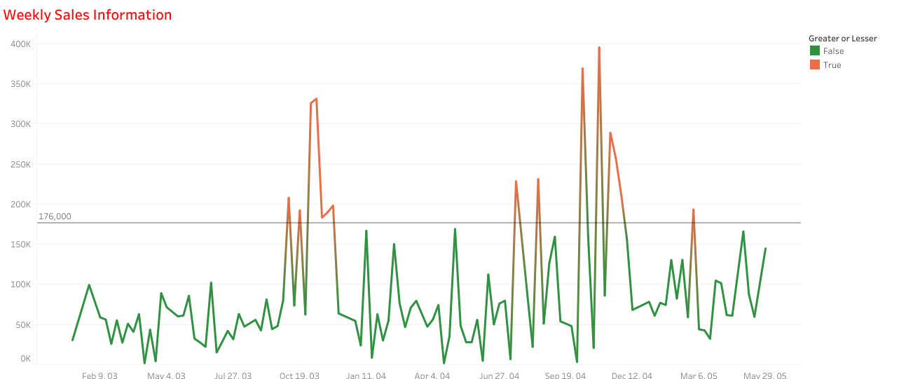
WEEKLY SALES INFORMATION
-From this chart we get weekly sales information.
-Chart shows there is high sales in october 2004 & november 2003 respectively.

Slide 5
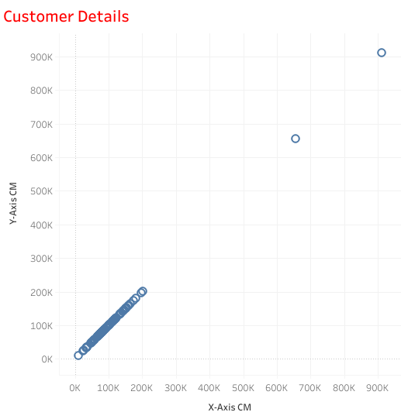
CUSTOMER DETAILS
-From this chart it is easy to find customer information based on quantity, sales & price.
-There is huge difference between top 2 & remaining customers in all measures.

Slide 6
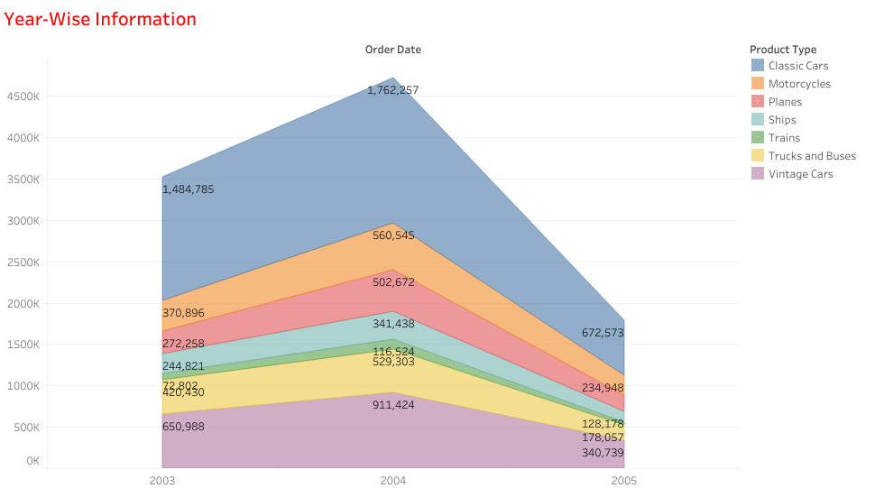
YEAR-WISE PRODUCT INFORMATION
-This graph gives us year-wise product information on the basis of different measures.
-It shows there is huge increase in sales in 2004.
-Classic cars, vintage cars, & motorcycle are the top 3 catagories in sales.

Slide 7
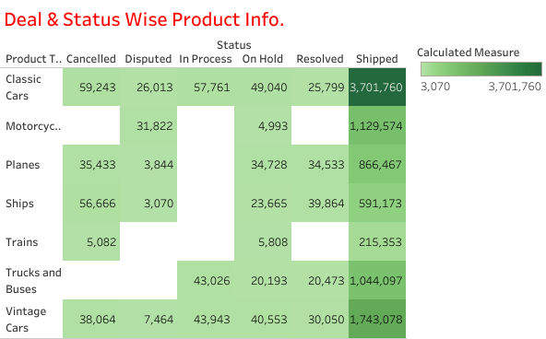
DEAL & STATUS-WISE INFORMATION
-This table is helpful for getting status-wise product information of different measures.

Slide 8
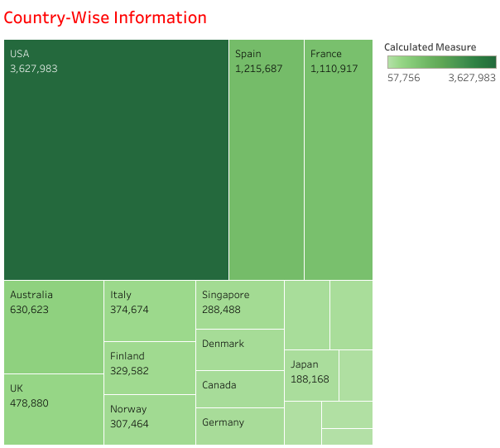
COUNTRY-WISE INFORMATION
-Using this treemap chart we get different information of different countries.
e.g. sales of each country, total quantity in each country.
-Top 3 countries
USA
SPAIN
FRANCE

Slide 9
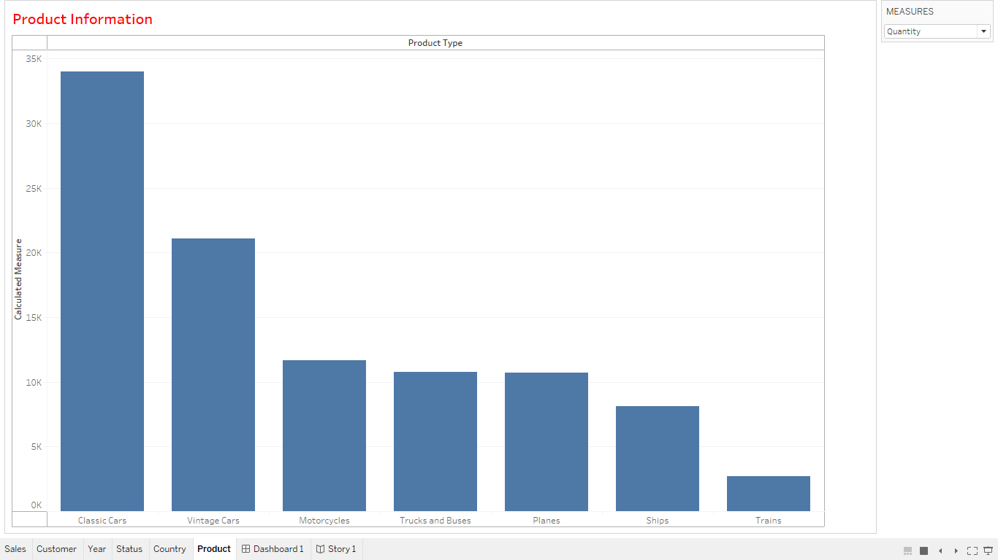
PRODUCT INFORMATION
From graph it is easy to find product information on the basis of sales, price& quantity.
-Classic cars, vintage cars, & motorcycle are the top 3 catagories in sales, quantity & price measures.

Slide 10
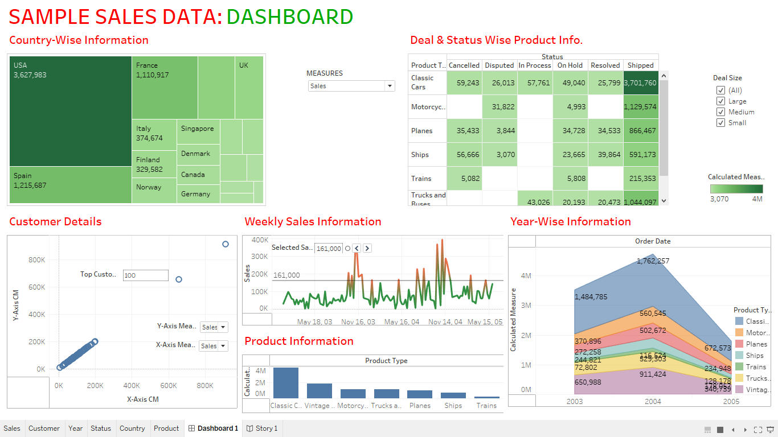
DASHBOARD

Slide 11
CONCLUSION
Classic cars, vintage cars, & motorcycle are the top 3 catagories in sales.
Top 3 countries in different measures:-
USA
SPAIN
FRANCE
High sales in october 2004 & november 2003 respectively.
There is huge difference between top 2 & remaining customers in all measures.

Slide 12
.
THANK YOU
.

